Slide 1
Accessing loosely structured data from F# and C#
Tomas Petricek
PhD Student
Microsoft C# MVP
http://tomasp.net/blog | @tomaspetricek

Slide 2
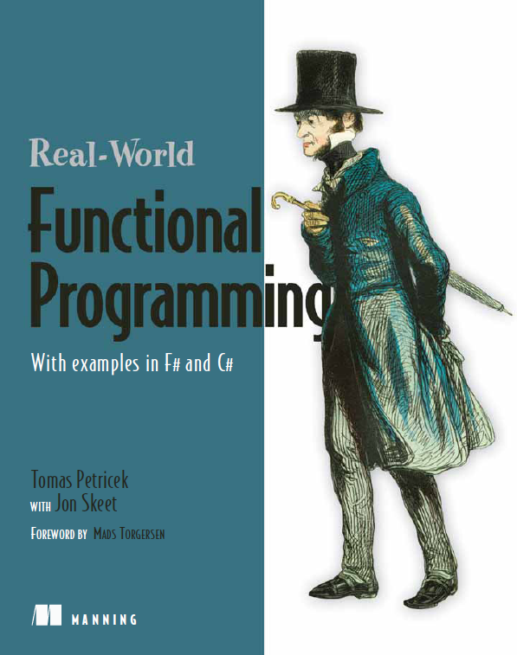
A little bit about me…
Real World Functional Programming
  Co-authored by Jon Skeet
  For C# developers
Worked on F# at MSR
  Internships & Contracting
  Blogged about F# in 2006
PhD Student at University of Cambridge

Slide 3

The Problem

Slide 4
The Problem
Structure in the language
  Classes with properties (C#)
  Data types or classes (F#)
Structure in the data source
  Database structure, XML schema (explicit)
  REST service or JSON file (implicit)
How to solve the impedance mismatch?

Slide 5
What you’ll learn today
“Design Patterns” for solving structure mismatch
  What options do we have in general
Interesting dynamic and reflection tricks
  Things you can implement in C# or F#
How F# type providers work
  Future F# technology that “brings data
  into the language, strongly typed”

Slide 6
Expression scale
  Using dynamic type or operator
Program scale
  Defining structure in the language
Internet scale
  Generate structure using type providers

Slide 7






Dynamic in C# and F#
Data have some structure
  Not understood by the compiler!
Structure specified locally “as needed”
  Example: Working with XML data
XmlElement element = GetElement();
int size = element.Attribute<int>("Size");

Slide 8





Dynamic in C# and F#
Dynamic type in C#
Dynamic operator in F#
dynamic element = GetElement();
int size = element.Size;
let element = GetElement();
let size = element?Size;

Slide 9
Demo:
Using WorldBank data in C#

Slide 10
Dynamic type in C#
Operations resolved at runtime
  Result is dynamic, but can be converted
dynamic wb = new DynamicWorldBank();
dynamic regions = wb.Region(new { PerPage = 100 });
class DynamicWorldBank : DynamicObject {
public override bool TryInvokeMember(InvokeMemberBinder binder,
object[] args, out object result) {
result = /* member access for 'binder.Name' */
return true;
}
}

Slide 11







Simple database access in F#
Operation resolved at compile-time
  Result has statically known type (not dynamic)
  Can be inferred from context
let getCategories() : seq<int * string> =
[ for row in db.Query?GetProducts() ->
row?ID, row?Name ]
let (?) (x:Row) (name:string) : 'R =
x.Reader.[name] :?> 'R

Slide 12
Demo:
Calling database in F#

Slide 13
Expression scale
  Using dynamic type or operator
Program scale
  Defining structure in the language
Internet scale
  Generate structure using type providers

Slide 14
Structure in the language
Describe the target structure
  Classes (for data), Interfaces (for operations)
Add additional hints to mapping
  .NET attributes, Configuration files
Automatically coerce data to the structure
  Examples: LINQ to SQL, PHP Interop

Slide 15
Domain modeling in LINQ
Data structure described as C# class
Match data to the structure
  Done at run-time & can fail
public partial class Books {
[Column(Storage="_ID", DbType="Int", IsPrimaryKey=true)]
public int ID { get; set; }
[Column(Storage="_Title", DbType="VarChar(100)")]
public string Title { get; set; }
}
var q = from p in db.GetTable<Books>()
select p.Title;

Slide 16
Domain modeling in F#
Simple way to think about data
  Compose data using simple constructors
Primitive values
  Single information (int, string, date)
Records
  Combines fixed number of other values
Discriminated unions
  Represents one of several options

Slide 17
Demo:
Nicer database access

Slide 18







Nicer database access in F#
Describe structure using F# types
Match data to the structure (dynamically)
  Type inferred from the context
type Book = { ID : int; Title : string }
let load() : seq<Book> =
let db = new DynamicDatabase(connectionString)
db.Query?GetBooks()

Slide 19
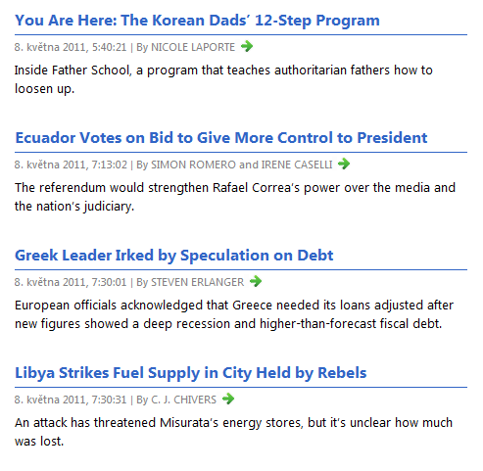
Domain modeling in F#

Slide 20
Domain modeling in F#
Define RSS feed structure in F#
type Title = Title of string
type Link = Link of string
type Description = Description of string
/// Item consists of title, link and description
type Item =
Item of Title * Link * Description
/// Represents channel with title (etc.) and list of items
type Channel =
Channel of Title * Link * Description * list<Item>
/// Represents RSS feed containing a channel
type Rss = Rss of Channel

Slide 21






Working with XML
Loading RSS feed
Summary: Key components
  Domain model in the language
  Library for matching data to the model
  Can fail if model is not in sync
let rss = StructuralXml.Load("http://.../feed")
match rss.Root with
| Rss(Channel(Title title, _, _, items)) ->
printfn "%s (%d items)" title items.Length

Slide 22
Demo:
Working with XML

Slide 23
Expression scale
  Using dynamic type or operator
Program scale
  Defining structure in the language
Internet scale
  Generate structure using type providers

Slide 24
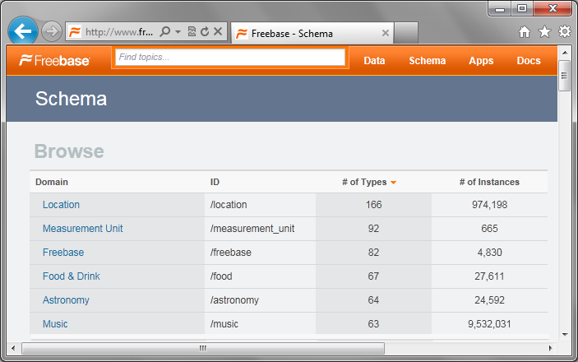
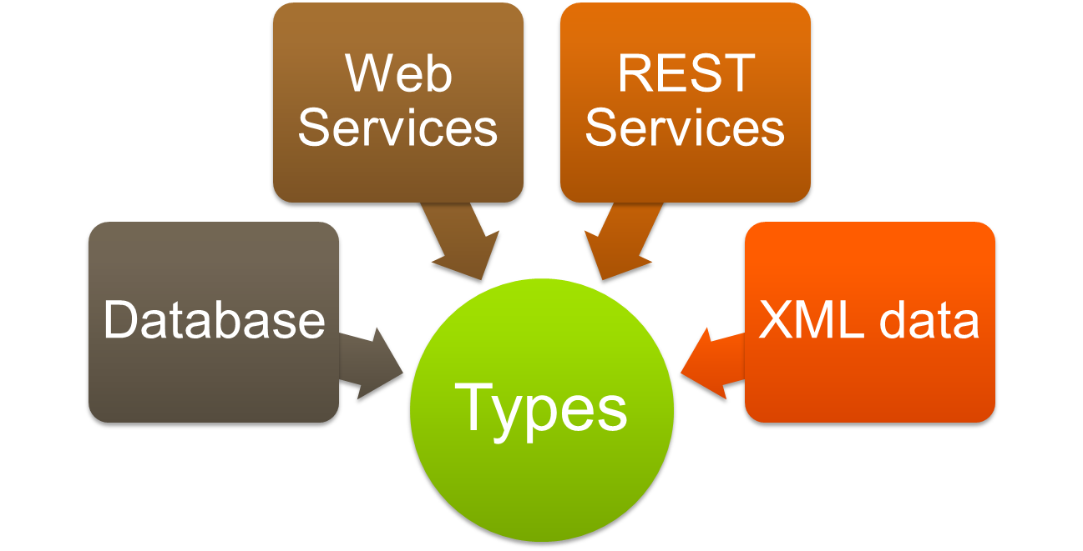
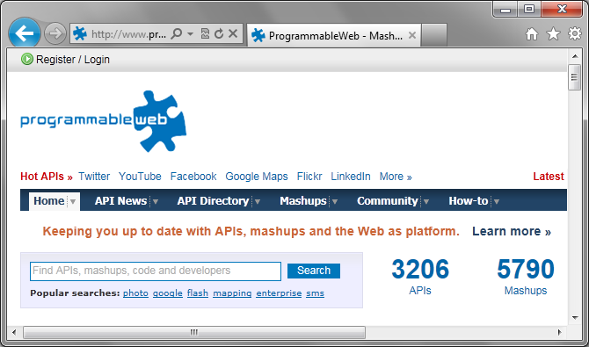


The Problem
Defining structure in the language doesn’t scale!

Slide 25
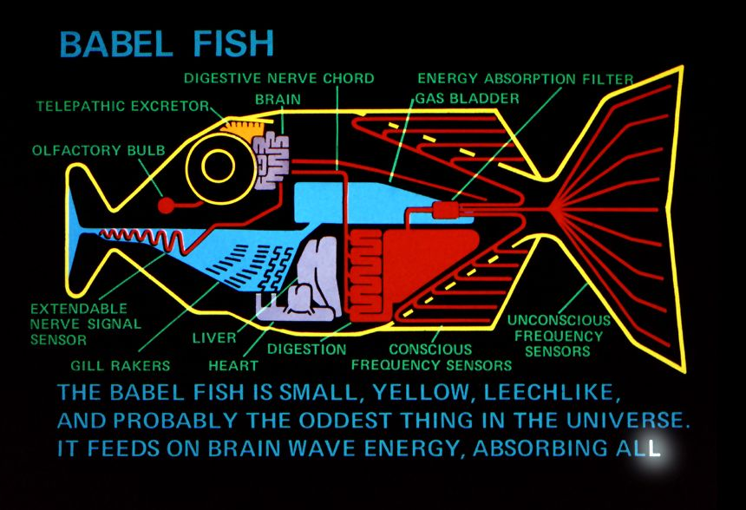
The Solution
Quick, stick this fish in your compiler!

Slide 26
Demo:
Accessing WorldBank data

Slide 27
What is a type provider?
Assembly containing a special type
Creating them is easier than it looks
  Method calls replaced by expressions
  …or you can generate real types
public interface ITypeProvider {
Type[] GetTypes();
Expression GetInvokerExpression
( MethodBase method,
ParameterExpression[] params );
event EventHandler Invalidate;
}

Slide 28
Type provider trickery
Gives you a new way of thinking
  This wasn’t really done before…
Delegates many questions to the provider
  Different views? Different versions?
  What if data source is not available?
F# is a great playground
  Object-oriented concepts help
  More information with units of measure

Slide 29
Demo:
Accessing Freebase data

Slide 30
Summary
Building a bridge between two structures
Dynamic type or operator
Domain model
Type providers
  Explicit
  Syntax in language
  Local scale (expression)
  Explicit
  Classes or data types
  Program or library scale
  Implicit
  Generated object types
  Web scale

Slide 31

Discussion
Questions & Answers?
F# training at SkillsMatter
  Functional Programming with .NET (27-28 October)
  Real-World F# Programming (15-16 December)
Contact
  http://tomasp.net | @tomaspetricek | tomas@tomasp.net

Slide 32
BONUS

Slide 33
World Bank provider details
At runtime countries & indicators are strings
  For example “GBR” or “GC.DOD.TOTL.GD.ZS”
  Members translated to runtime functions
type Runtime =
static member GetValuesByCountryAndIndicator
(country:string, indicator:string) : seq<int * float> =
seq { for (k, v) in WorldBank.GetData [country; indicator] do
if not (String.IsNullOrEmpty v) then
yield int k, float v }
static member GetCountriesByRegion(code:string) : seq<string> =
seq { for (key, _) in WorldBank.GetCountries(code) -> key }

Slide 34
Calling PHP from C#
Dynamically typed PHP object
Required structure specified as a C# interface
class SampleObj {
function Add($a, $b) { return $a + $b; }
}
[DuckType]
public interface ISampleObj {
int Add(int i1, int i2);
}
ISampleObj so = ctx.New<ISampleObj>("SampleObj");
int res = so.Add(18, 26);

